Slide 1
Spatial Data Analysis in Power BI
Tony McGovern, Data Scientist, emdata Moderated By: Jason Lee
Notes:
[Moderator Part]
Hello and welcome everyone to this PASS Marathon: Analytics!
We’re excited you could join us today for Tony McGovern’s session, Spatial Data Analysis in Power BI.
This PASS Marathon features back-to-back live webinars, delivered by expert speakers from the PASS community.
The sessions will be recorded and posted online after the event. You will receive an email letting you know when the recordings are available.
My name is Carlos Garcia [you can say a bit about yourself here if you’d like]
I have a few introductory slides before I hand over the reins to Tony.
[move to next slide]

Slide 2



Tony McGovern
Biography Point One
Over 12 years experience as a data scientist, working with Fortune 100 clients and creating high-impact analytics for projects such as the Troubled Asset Relief Program
Biography Point Two
Data Scientist, emdata
With his partner Ashleigh McGovern, he co-founded emdata, a data design and analytics firm that helps clients build data capabilities and solutions
tonymcgovern.com
Biography Point Three
/tony-mcgovern-1ab6778/
Former Principal Oboist of the Washington Symphonic Orchestra. Has played with the National Symphony Orchestra, Phoenix Symphony Orchestra, among others
@tonmcg
tony@emdata.ai
Notes:
[Moderator Part]
This PASS Marathon session is presented by Tony McGovern. Tony finds the whole process of discovering, cleaning, analyzing, and visualizing data extremely rewarding. He has both an endless love for cutting-edge technologies and a dogged determination to solve the difficult problems others run away from. During the day, he uses machine learning models and data mining techniques to solve hard, analytical problems for his clients and when it's time to show the results of his analysis, he often turn to Power BI, Shiny, or D3.js to build expressive, interactive applications.
[move to next slide]

Slide 3
Spatial Data Analysis in Power BI
Tony McGovern, Data Scientist, emdata Moderated By: Carlos Garcia
Notes:
And without further ado, here is Tony with Spatial Data Analysis in Power BI.
{speaker begins}
**[Speaker takes over]**

Slide 4
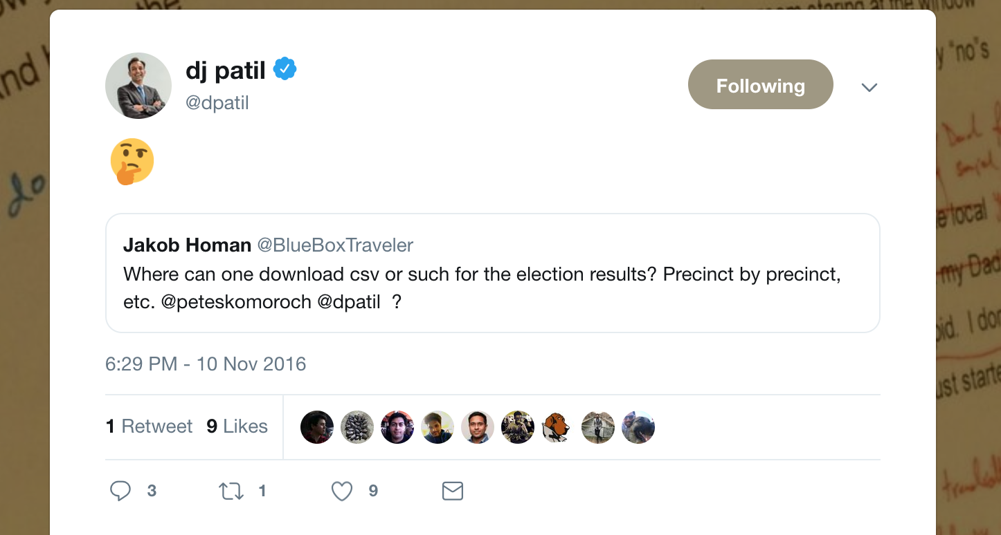
It All Started with a Tweet …
Notes:
On Saturday morning, November 12th 2016, four days after the results of the U.S. presidential election, I read this on Twitter.
Surely this has to be an easy Bing search. Is it true that lower-level U.S. presidential election results are no where to be found? I see them everywhere: NYTimes, Washington Post, CNN, BBC, etc.
After putzing around for 20 or so minutes, I found out that yes, that data is available, but it's not open data. It's not available for me and you.
So, with the blessing of my wife and kids, I set out that day to change that.

Slide 5
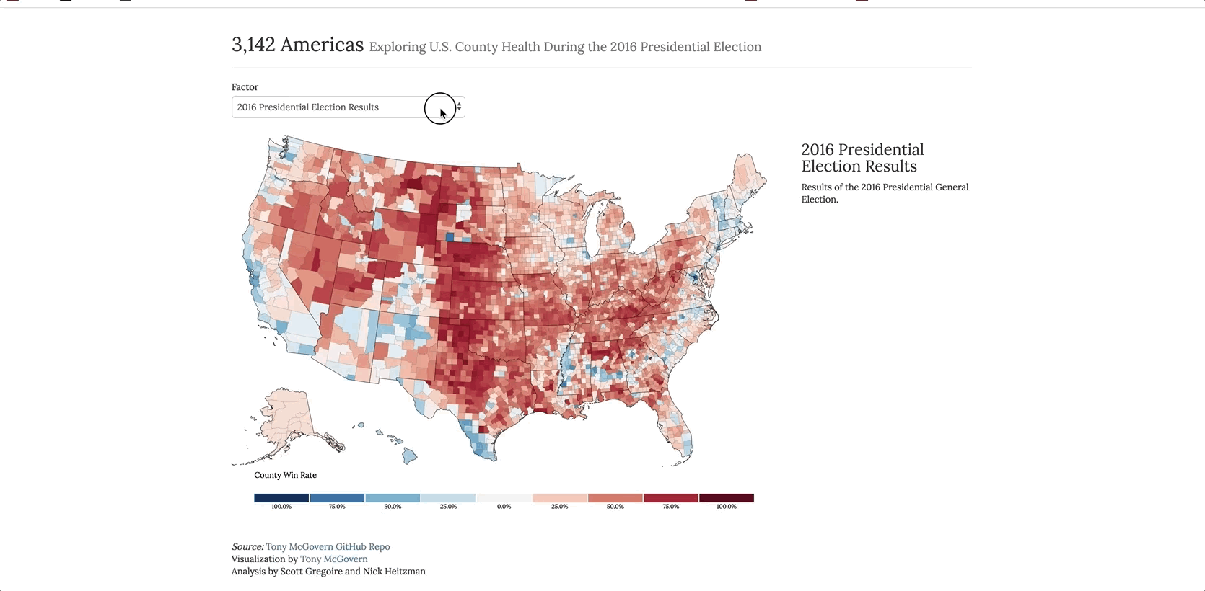
Beautiful Thematic Maps (Not in Power BI)
Notes:
WHAT'S THE STORY?
So I set about trying to explain the results of the election through visuals and analysis. And what did I learn? Not only was county-level U.S. 2016 election data nowhere to be found, simple maps that showed these results, or these results with other data were non existent. So I created those as well.
Subscribers to the NYTimes or the Washington Post shouldn't be the only ones who have access to county-level election data or maps.
After 120+ hours scraping websites with Python, creating interactive maps with JavaScript, and performing analysis in R, I realized a few important lessons:
- it's hard to update this data
- it's even harder to update the map
- it's super duper hard to perform advanced analytics and share it with the world.
WHY IS THIS IMPORTANT?
Power BI offers us a better way. With Power BI, you can get and update the data more more easily, update the maps with great third party visuals, and perform advanced analytics that you can share with the world.
TAKEAWAY:
We have the power to make data and advanced analytics more open, more robust, and more widely available

Slide 6
Session Agenda
Explore how Mapbox helps you create beautiful thematic maps
Understand what out of the box tools are available in the service
Notes:
Create beautiful thematic maps in Power BI
Understand what out of the box tools are available to enhance analysis

Slide 7
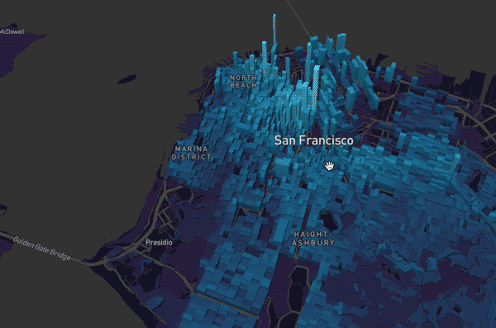
Mapbox makes the (spatial) world more open
Notes:
WHAT'S THE STORY?
WHY IS IT IMPORTANT?
WHAT'S THE TAKEAWAY?

Slide 8
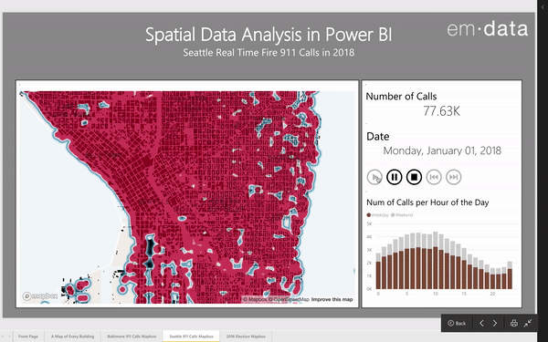
What We’re Going to See Today: Mapbox Visual

Slide 9
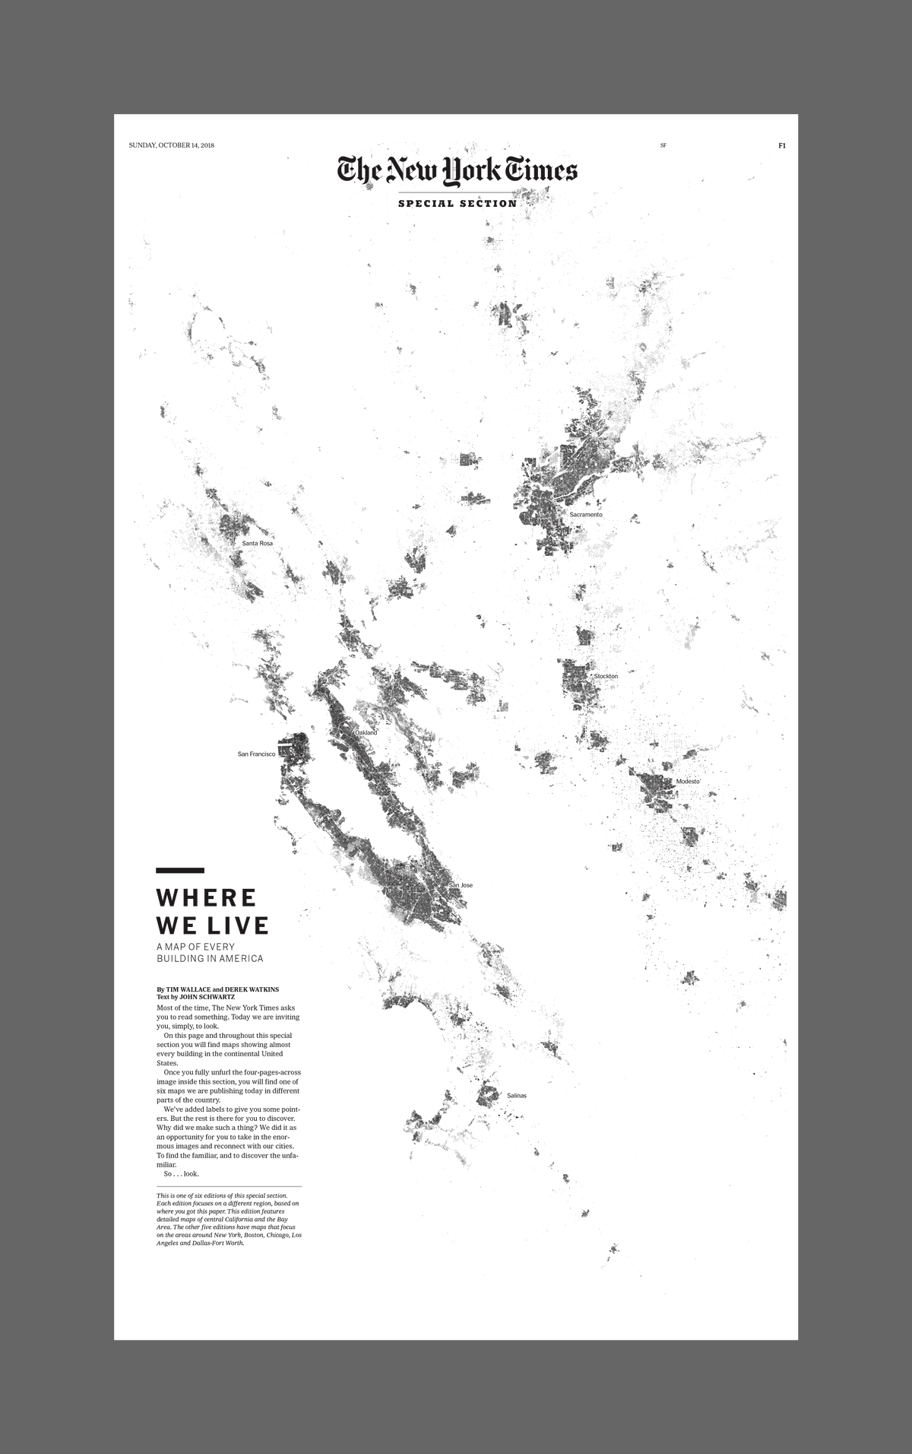
Bonus Visual: A Map of Every Building in America
Notes:
And as a bonus, we'll walk through how to download a layer of every building in Washington State and use it within a Mapbox Visual. Neat, huh?
Now before we get to it, a quick poll:
- who here has used either the Esri ArcGIS Visual or the Mapbox Visual?

Slide 10
Setting Up a Mapbox Account

Slide 11
Using Mapbox Tilesets

Slide 12
Setting Mapbox Styles

Slide 13
Coordinates Data: Heat maps

Slide 14
Boundary Data: Extrusions

Slide 15
Resources
Open Source Election Results https://github.com/tonmcg/US_County_Level_Election_Results_08-16
United States Census API https://api.census.gov/data.html
Socrata Open Data API https://dev.socrata.com/
Mapbox Studio https://www.mapbox.com/studio/
A Map of Every Building in America https://github.com/Microsoft/USBuildingFootprints
PowerSocrata https://github.com/tonmcg/powersocrata
Notes:
Create beautiful thematic maps in Power BI
Use those maps for impactful spatial analysis
Understand how to mix in machine learning to your Power BI reports

Slide 16
Questions?
Notes:
[Moderator Part]
Moderator to Address questions in order of relevance if any and thank the Speaker
[move to next slide] Coming up next

Slide 17
Learn more from Tony McGovern
@tonmcg
tony@emdata.ai
Notes:
[Moderator Part]
Thank you all for attending!
[move to next slide]

